Slide 1
ShadowFox Data Science
Author: Harish T S

Slide 2
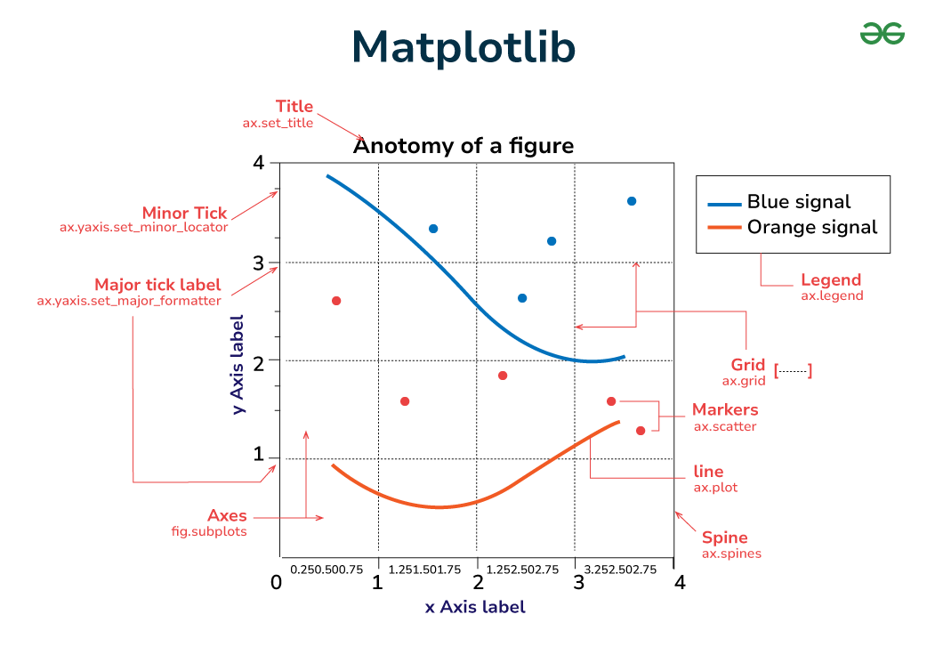
Matplotlib
Matplotlib is one of the most widely used Python libraries for creating static, interactive, and animated visualizations.
It serves as a foundation for other libraries like Seaborn, offering a high degree of control over plot aesthetics.
It is particularly useful for generating publication-quality figures in a variety of formats.
• Typical Use Cases: Line plots, scatter plots, histograms, and subplots for data analysis and research.
• Unique Features: Extensive customization options, ability to export figures to multiple formats (PNG, PDF), and fine-grained control over every element of a plot.

Slide 3
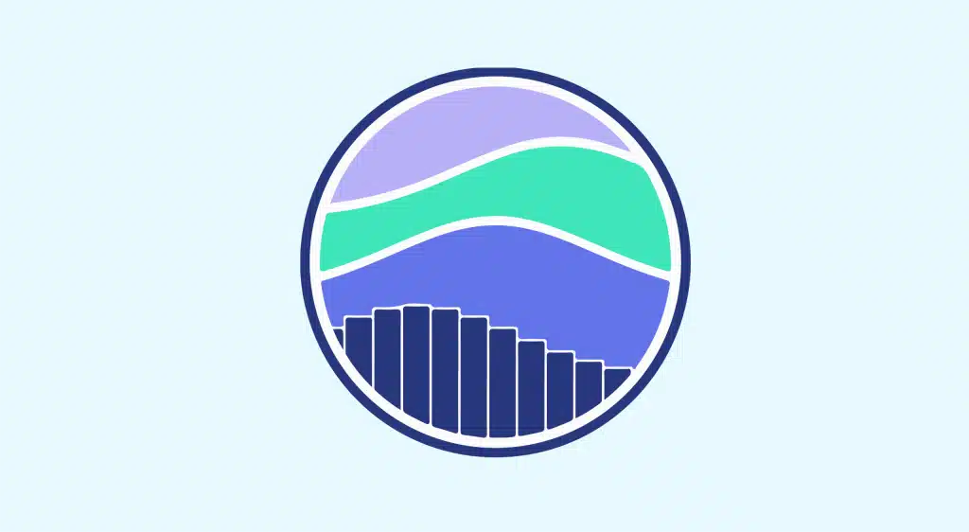
SEaborn
Seaborn is a statistical data visualization library built on top of Matplotlib.
It provides a high-level interface for drawing attractive and informative statistical graphics.
Seaborn simplifies complex visualization processes and automatically manages many of the styling and plotting intricacies, making it ideal for exploratory data analysis.
• Typical Use Cases: Statistical visualization, data distributions, heatmaps, and complex multiplot grids.
• Unique Features: Built-in themes, color palettes, and integration with Pandas for seamless plotting.

Slide 4
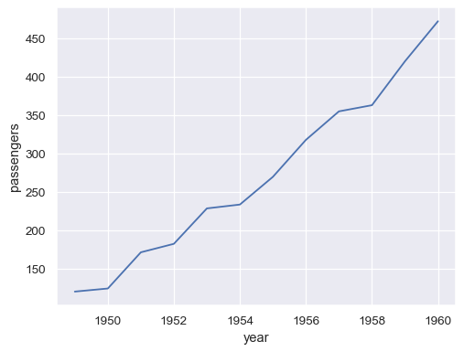
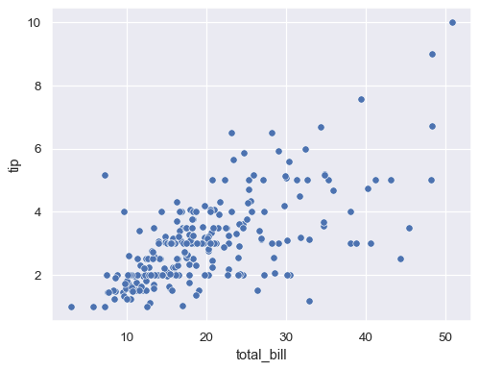
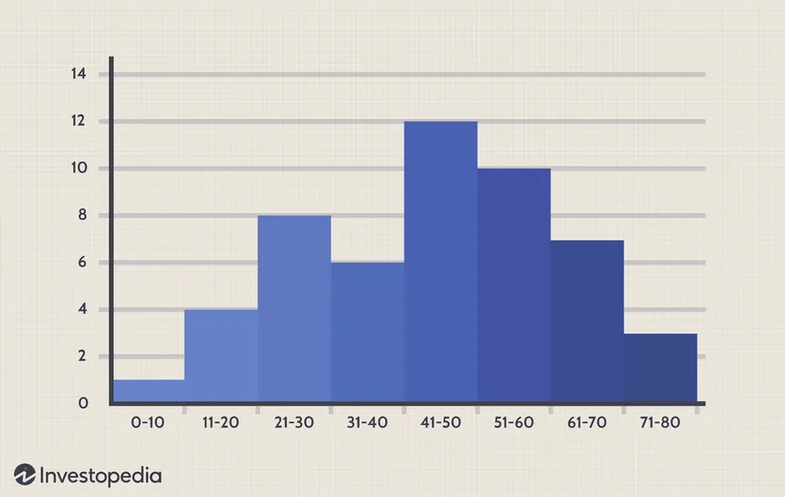
Graph Types Matplotlib Graphs
1. Line Plot
Description: Displays data as a series of points connected by straight lines. Useful for tracking changes over time.
2. Scatter Plot
Description: Visualizes the relationship between two numerical variables. Each point represents an observation.
3. Histogram
Description: Represents the distribution of a dataset by grouping data into bins.

Slide 5
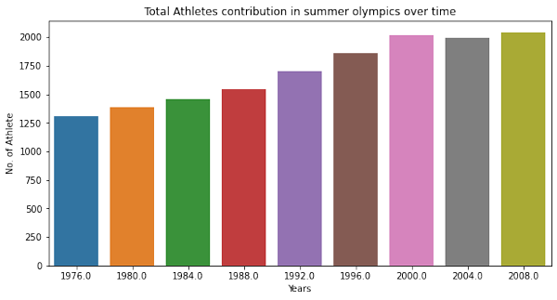
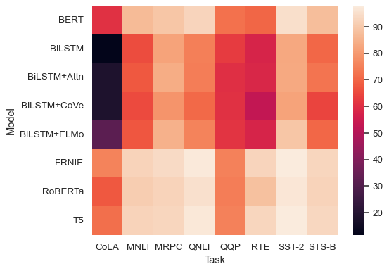
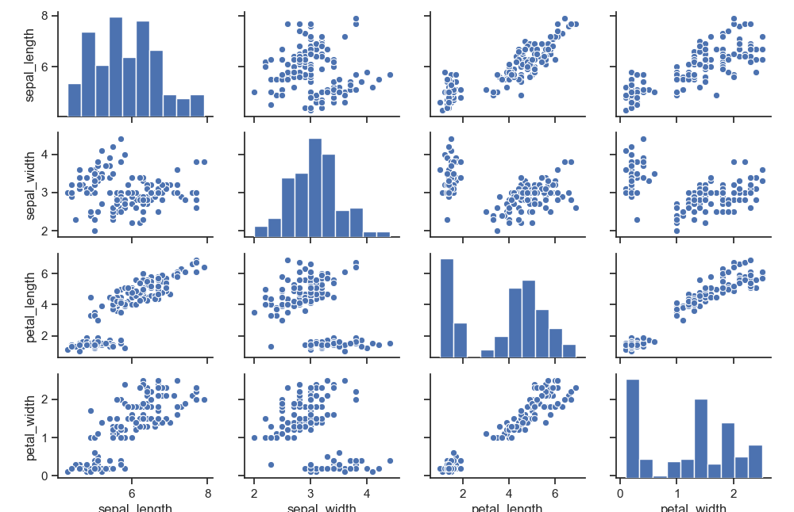
Graph Types SEaborn Graphs
1. BAR Plot
Description: Displays categorical data with rectangular bars. Each bar's height is proportional to the count or value it represents.
2. Heatmap
Description: Shows a matrix of data values with color-coding to indicate different ranges of values. Useful for displaying correlations.
3. Pair plot
Description: Creates a matrix of scatter plots for all numerical variables in a dataset, along with histograms for each variable.

Slide 6
Matplotlib vs SEaborn
Feature | Matplotlib | Seaborn
Ease of Use | High learning curve due to extensive customization options. | User-friendly, especially for creating complex statistical plots quickly.
Customization | Offers detailed control over every plot element, but can require more code. | Less customizable but has sensible defaults for style and layout.
Interactivity | Basic interactivity, better suited for static plots. | Limited interactivity; mainly for static plots.
Performance | Good performance for medium datasets but may slow down with very large datasets. | Built on Matplotlib, so performance is similar. Handles large datasets well for statistical plots.
Strengths | Highly customizable, supports a wide range of plot types. | Easy to create visually appealing plots with minimal effort, strong integration with Pandas.
Weaknesses | Requires more code for common tasks, and the syntax can be verbose. | Less flexible for detailed customization compared to Matplotlib.

Slide 7
Beginner Task
Double Click on the above pdf to view assignment

Slide 8
Intermediate Task
Report on Air Quality Analysis Code
The provided code conducts an analysis of air pollutant levels in Delhi using a dataset containing various air quality metrics over time. It leverages libraries such as Pandas for data manipulation, Matplotlib for plotting, and Seaborn for correlation visualization.
1. Data Loading and Initial Processing:
* The dataset is loaded from a CSV file, and the first few rows are printed for an initial overview.
* Dates are converted to a 'datetime' format for easier manipulation.
* Missing values are removed to ensure a clean dataset for analysis.
2. Descriptive Statistics:
* The 'describe()' function generates summary statistics (count, mean, std, min, max, etc.) for the pollutant levels, offering insight into the distribution of the data.

Slide 9
3. Time Series Visualization: * A line plot is created to visualize the concentrations of various pollutants over time. This helps identify trends, spikes, and seasonal patterns in air quality. 4. Hourly Average Analysis: * The dataset is enriched by extracting the hour and month from the date. * Average pollutant levels are calculated by hour, allowing for a deeper understanding of daily pollution patterns. * A bar plot visualizes these hourly averages. 5. Correlation Analysis: * A correlation matrix is computed to analyze the relationships between different pollutants. * A heatmap is generated to visualize these correlations, helping to identify which pollutants may be associated with one another.

Slide 10
Graphs used and their definitions
1. Time Series Plot:
A line graph displaying the levels of air pollutants (e.g., CO, NO2, PM2.5) over time.
Where it is used: To visualize trends and variations in air quality over the specified period.
2. Hourly Averages Plot:
A bar graph showing average pollutant concentrations for each hour of the day.
Where it is used: To identify peak pollution hours and understand daily cycles in air quality.
3. Correlation Heatmap:
A graphical representation of the correlation coefficients between pairs of pollutants.
Where it is used: To assess the relationships among pollutants, indicating how changes in one may be associated with changes in another.

Slide 11
Overall results of the code
1. Trends: The time series plot highlights fluctuations in pollutant levels, indicating periods of higher pollution. Seasonal variations may also be visible, suggesting environmental or anthropogenic factors influencing air quality.
2. Daily Patterns: The hourly average plot reveals typical pollution trends throughout the day, which can be critical for public health and policy decisions, indicating times when pollution is at its peak.
3. Correlations: The heatmap shows the relationships between various pollutants, which can inform further studies on sources of pollution and their combined effects on health and the environment.
Conclusion
This analysis provides valuable insights into air quality trends and patterns in Delhi. The visualization techniques employed not only enhance understanding of the data but also support further research and decision making related to air quality management. By continuing to analyze these trends and correlations, stakeholders can better address air pollution issues in the region

Slide 12
Intermediate Task
Double Click on the above pdf to view assignment

Slide 13
Thank you

